Slide 1


Slide 2

What is MYSQL?
MySQL is currently the most popular database management system software used for managing the relational database.
It is open-source database software, which is supported by Oracle Company. It is fast, scalable, and easy to use database management system in comparison with Microsoft SQL Server and Oracle Database.
MySQL is the relational database management system.
MySQL used for developing web based software development.
Developed by Company MySQL AB a Swedish company.

Slide 3
WHAT IS DATABASE?
A database is an application that stores the organized collection of records.
It can be accessed and manage by the user very easily.
It allows us to organize data into tables, rows, columns, and indexes to find the relevant information very quickly.
Each database contains distinct API for performing database operations such as creating, managing, accessing, and searching the data it stores.

Slide 4
Features of MySQL
Relational Database Management System (RDBMS)
Easy to use
Storing data is secure.
Open Source & Free to download.
Compatible on many operating systems.

Slide 5
What is RDBMS?
RDBMS stands for Relational Database Management Systems..
All modern database management systems like SQL, MS SQL Server, IBM DB2, ORACLE, My-SQL and Microsoft Access are based on RDBMS.
It is called Relational Data Base Management System (RDBMS) because it is based on relational model introduced by E.F. Codd.
Data is represented in terms of tuples (rows) in RDBMS. Relational database is most commonly used database.
Relational database is most commonly used database. It contains number of tables and each table has its own primary key. Due to a collection of organized set of tables, data can be accessed easily in RDBMS.

Slide 6
Unique Key:
A unique key in MySQL is a single field or combination of fields that ensure all values going to store into the column will be unique. It means a column cannot stores duplicate values.
For example, the email addresses and roll numbers of students in the "student_info" table or contact number of employees in the "Employee" table should be unique.
It is useful in preventing the two records from storing identical values into the column.
It stores only distinct values that maintain the integrity and reliability of the database for accessing the information in an organized way.
It also works with a foreign key in preserving the uniqueness of a table.
It can contain null value into the table.
Syntax
CREATE TABLE table_name(
col1 datatype,
col2 datatype UNIQUE,
...
);
REFER WITH EXAMPLE: https://www.javatpoint.com/mysql-unique-key

Slide 7
Primary Key:
MySQL primary key is a single or combination of the field, which is used to identify each record in a table uniquely. If the column contains primary key constraints, then it cannot be null or empty. A table may have duplicate columns, but it can contain only one primary key. It always contains unique value into a column.
When you insert a new row into the table, the primary key column can also use the AUTO_INCREMENT attribute to generate a sequential number for that row automatically.
Rules for Primary key
The primary key column value must be unique.
Each table can contain only one primary key.
The primary key column cannot be null or empty.
MySQL does not allow us to insert a new row with the existing primary key.
It is recommended to use INT or BIGINT data type for the primary key column.

Slide 8
Syntax:
CREATE TABLE table_name
(
col1 col_definition,
col2 col_definition,
...
CONSTRAINT [constraint_name]
PRIMARY KEY (column_name(s))
);
Refer link with example:
https://www.javatpoint.com/mysql-primary-key

Slide 9
Foreign Key:
The foreign key is used to link one or more than one table together. It is also known as the referencing key. A foreign key matches the primary key field of another table. It means a foreign key field in one table refers to the primary key field of the other table. It identifies each row of another table uniquely that maintains the referential integrity in MySQL.
SYNTAX
[CONSTRAINT constraint_name]
FOREIGN KEY [foreign_key_name] (col_name, ...)
REFERENCES parent_tbl_name (col_name,...)
ON DELETE referenceOption ON UPDATE referenceOption
REFER WITH EXAMPLE:
https://www.javatpoint.com/mysql-foreign-key

Slide 10
What is Database?
SERVER (Transfer HTTP Request ) DATABASE
(User Data’s are stored )
CLIENT ( We will access the software's in Mobile or computers/laptops).
MySQL
ORACLE
SQL SERVER

Slide 11
What is Database & Tables MySQL? BACKEND RDBMS
COLLEGE DATABASE
PRIMARY KEY
COURSE
CID
COURSENAME
COURSE_TYPE
SUBJECTS
SUID
DUB_NAME
CID
COURSE_YEAR
SEM
APPLICATION
ID
NAME
FATHER
CID
ROLLNO
UNIQUE CID
ATTENDANCE
AID
ATT_DATE
ID
RELIGION
ROLLNO
FOREIGN KEY
Tables

Slide 12
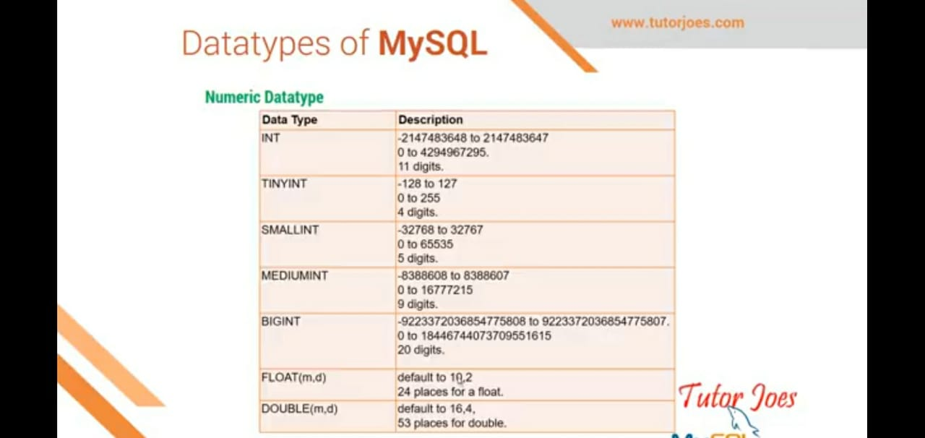
Datatypes of MySQL

Slide 13
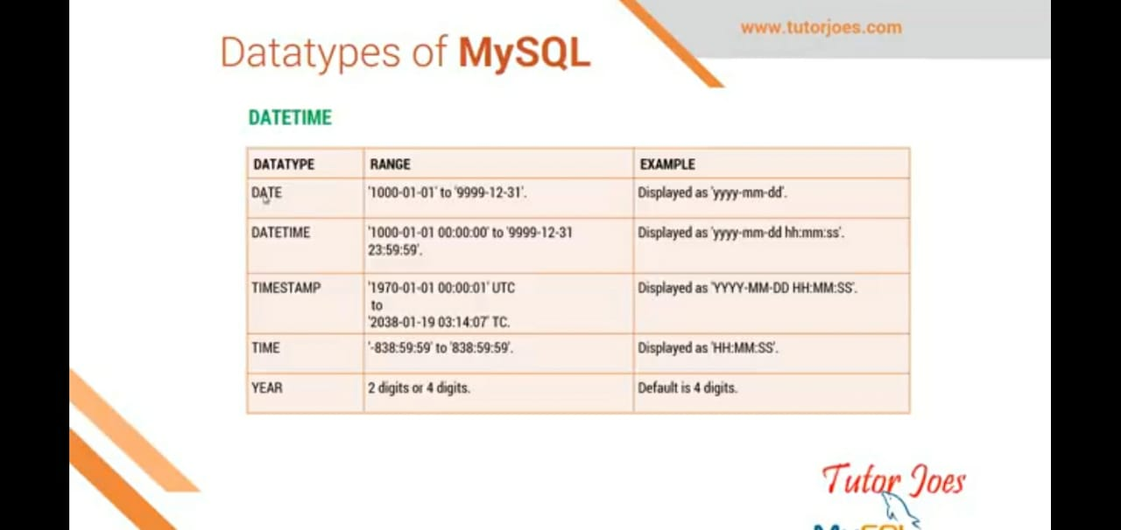

Slide 14
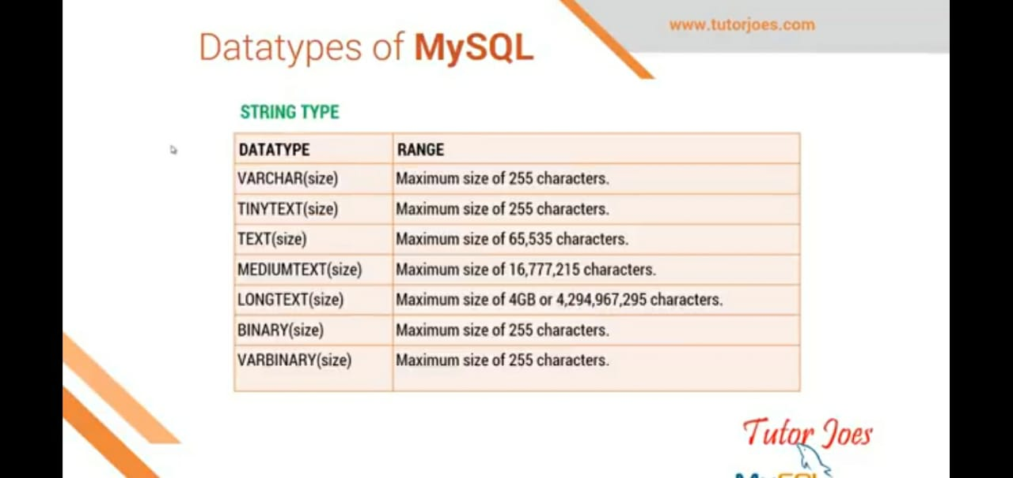

Slide 15
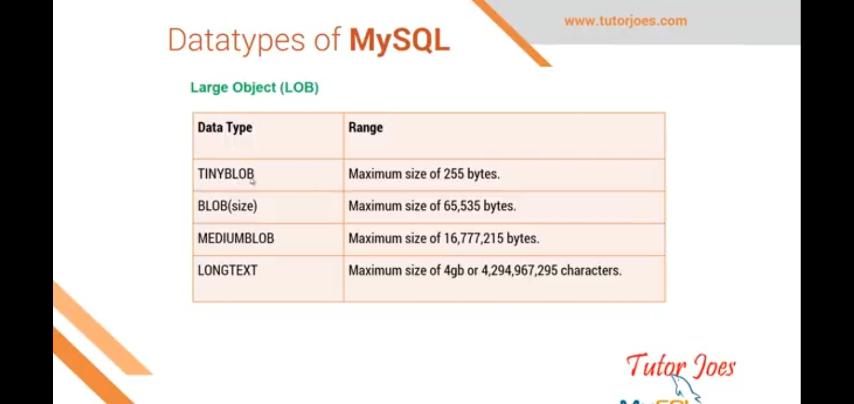

Slide 16
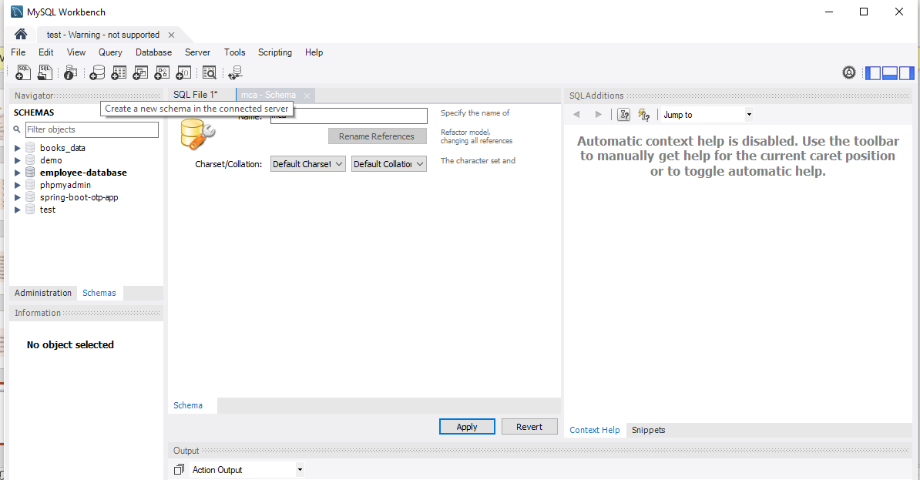
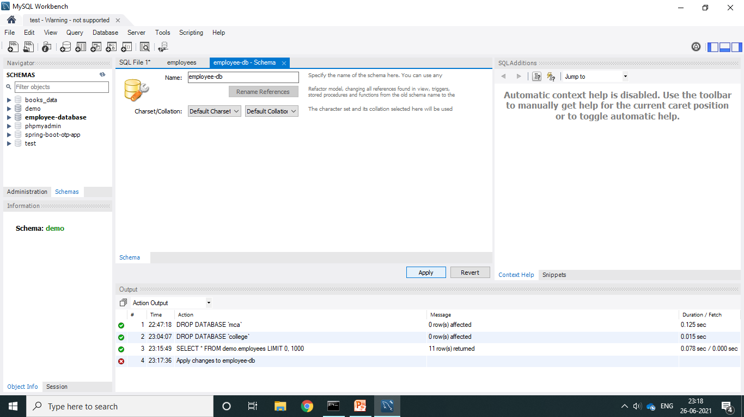
Creating a database in MySQL workbench

Slide 17
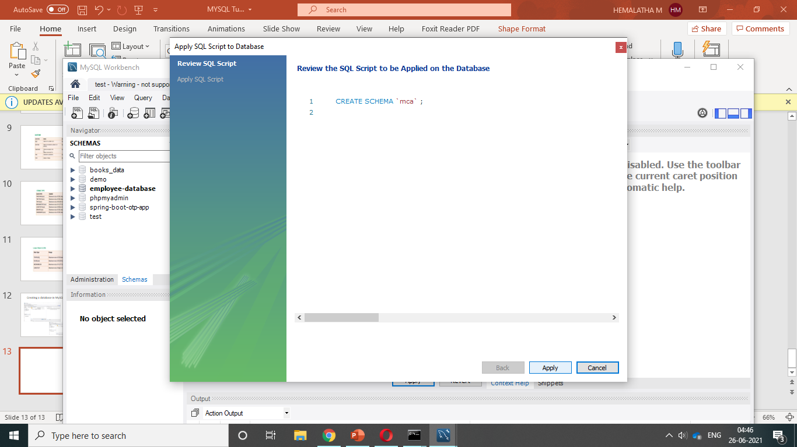
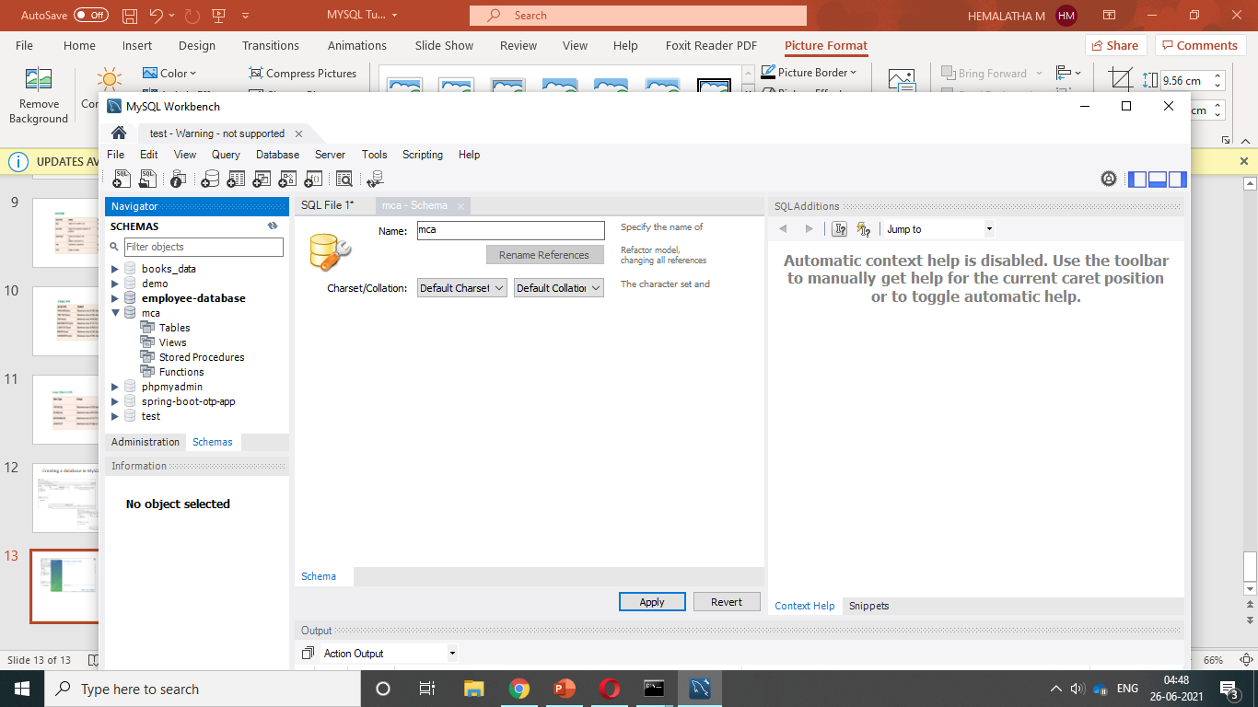

Slide 18
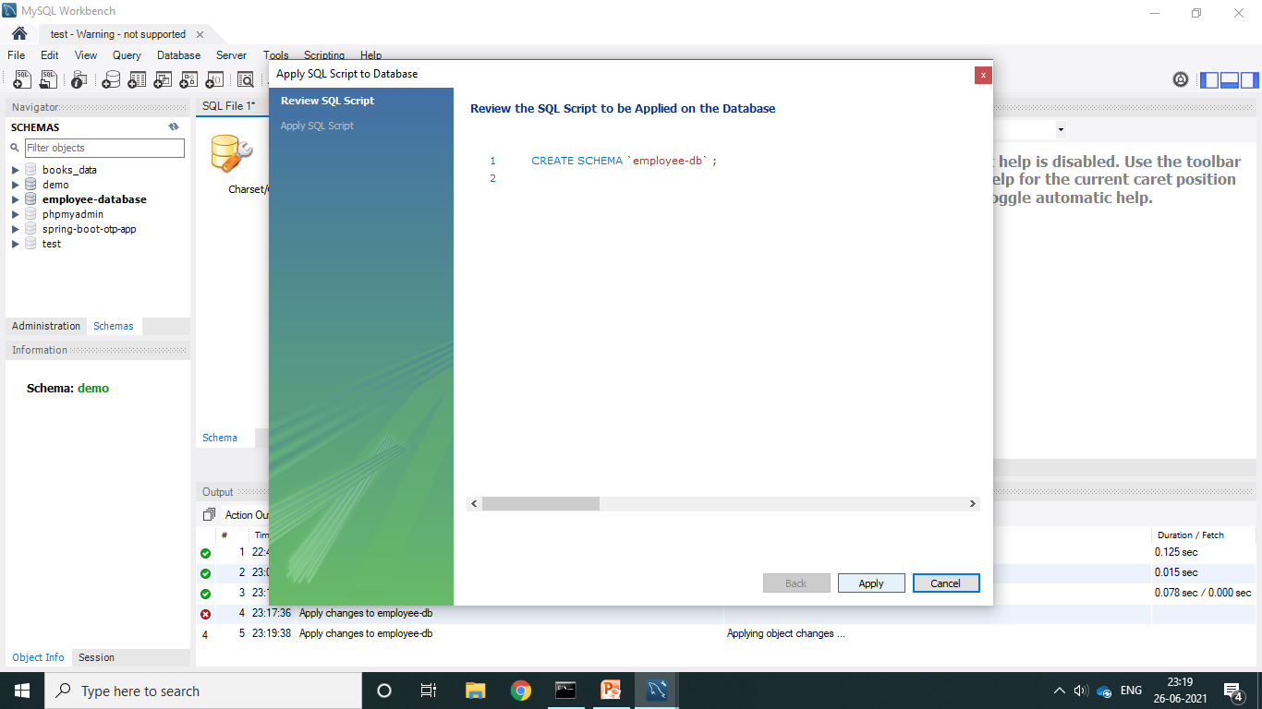
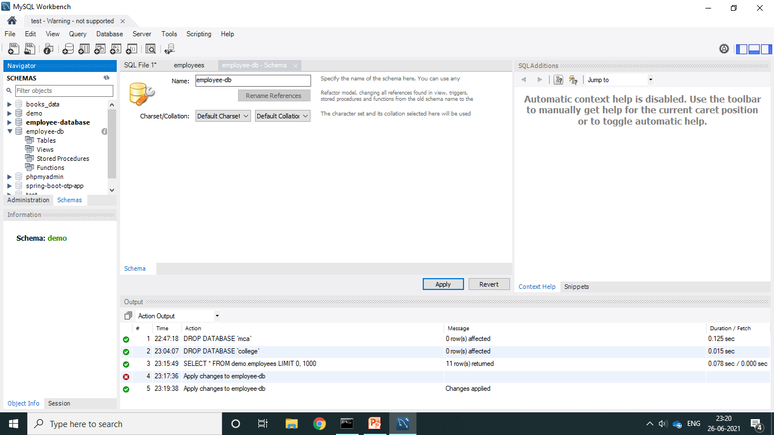

Slide 19
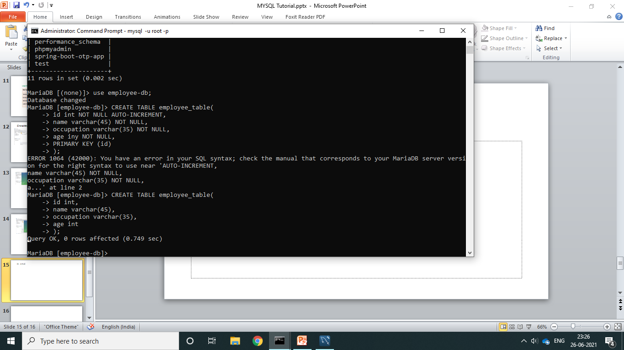
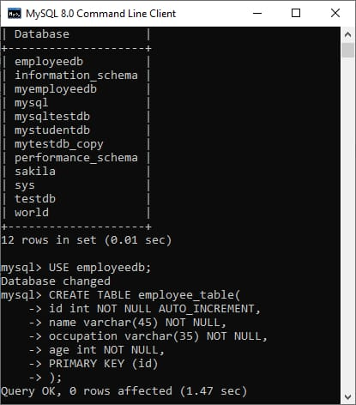
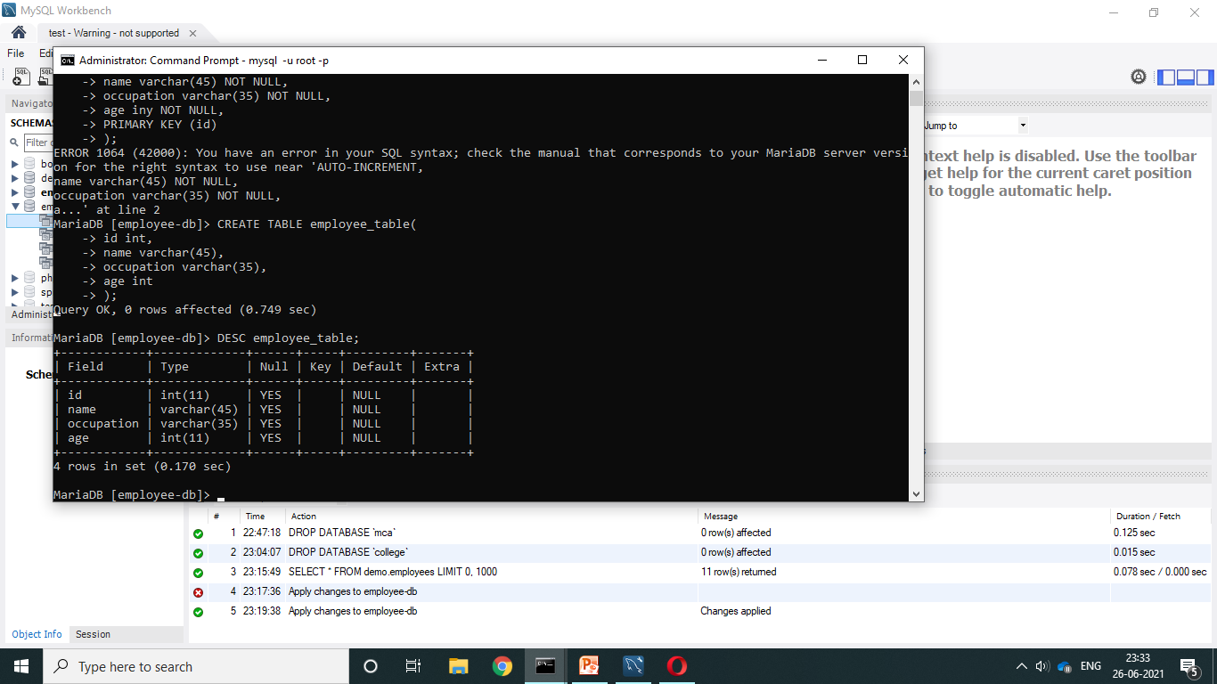
CREATE TABLE :

Slide 20
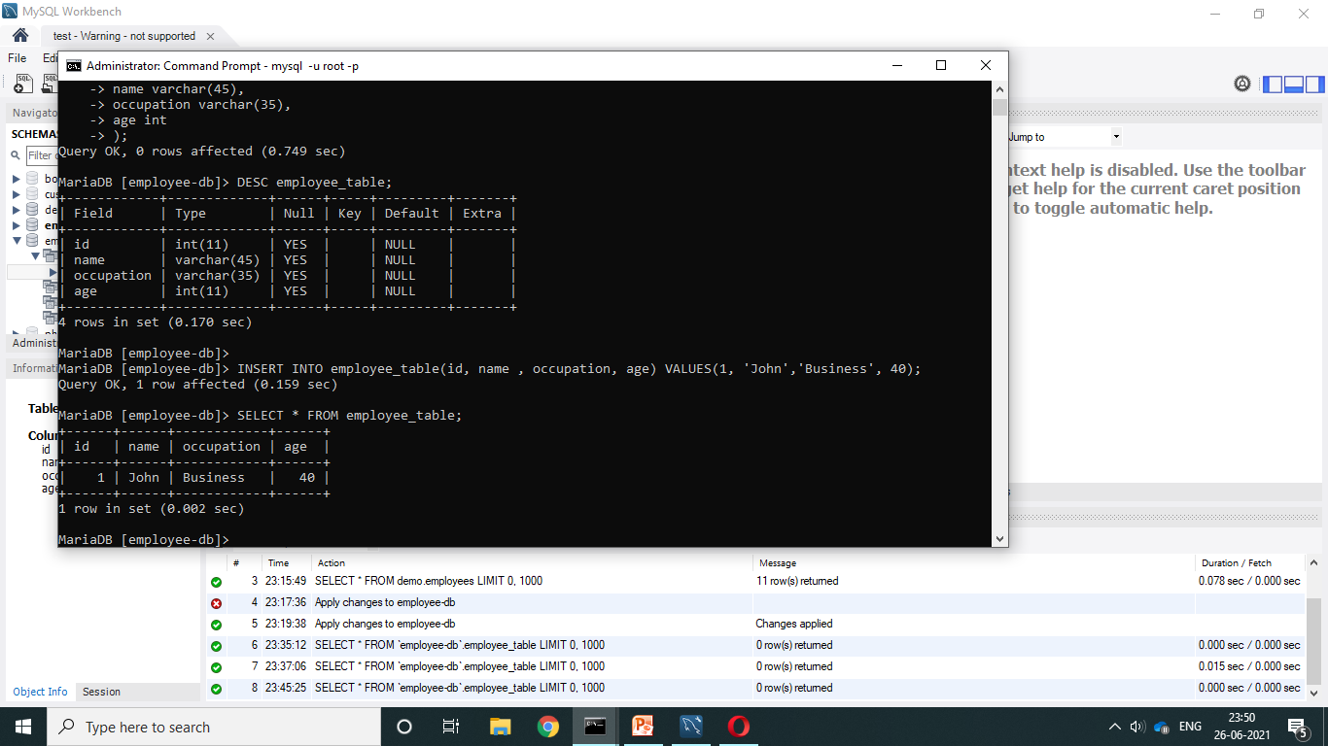
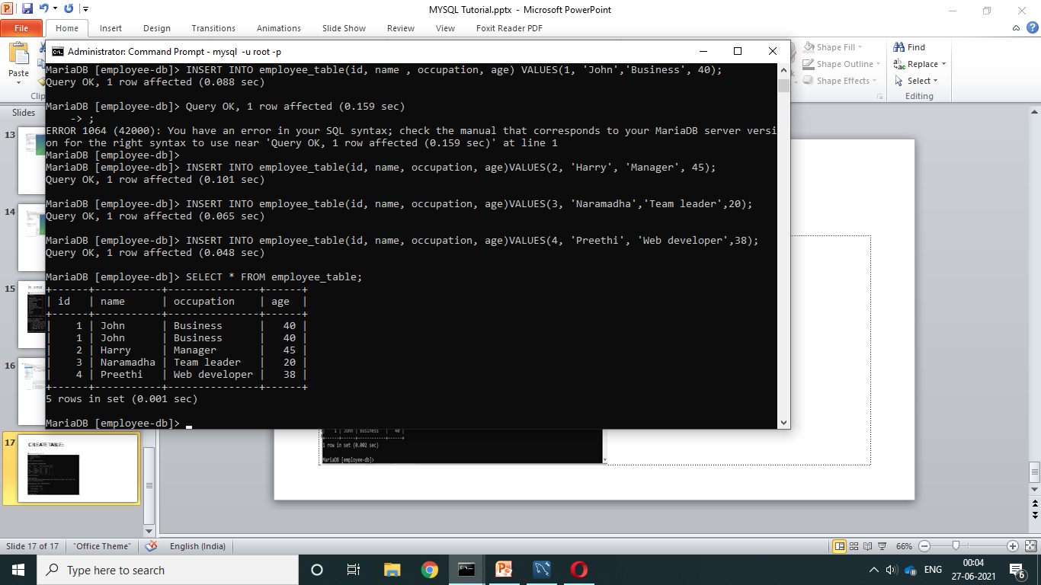
INSERT INTO TABLE VALUES :

Slide 21
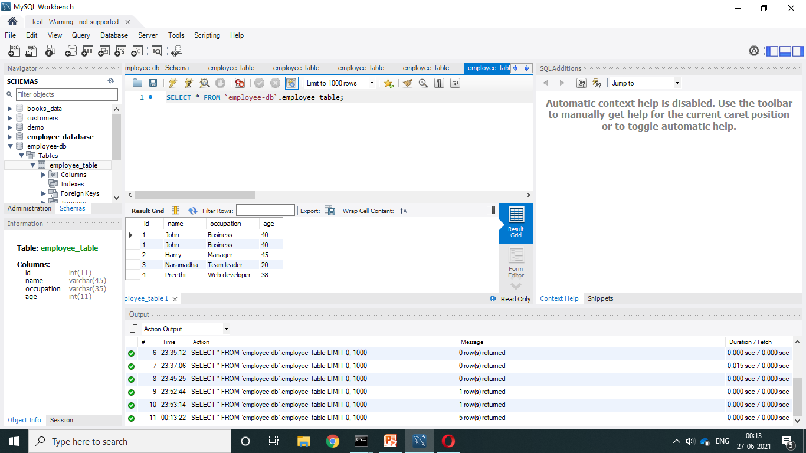
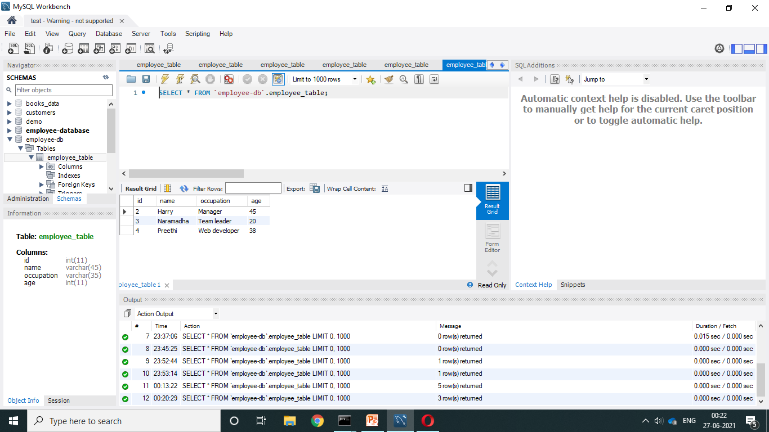
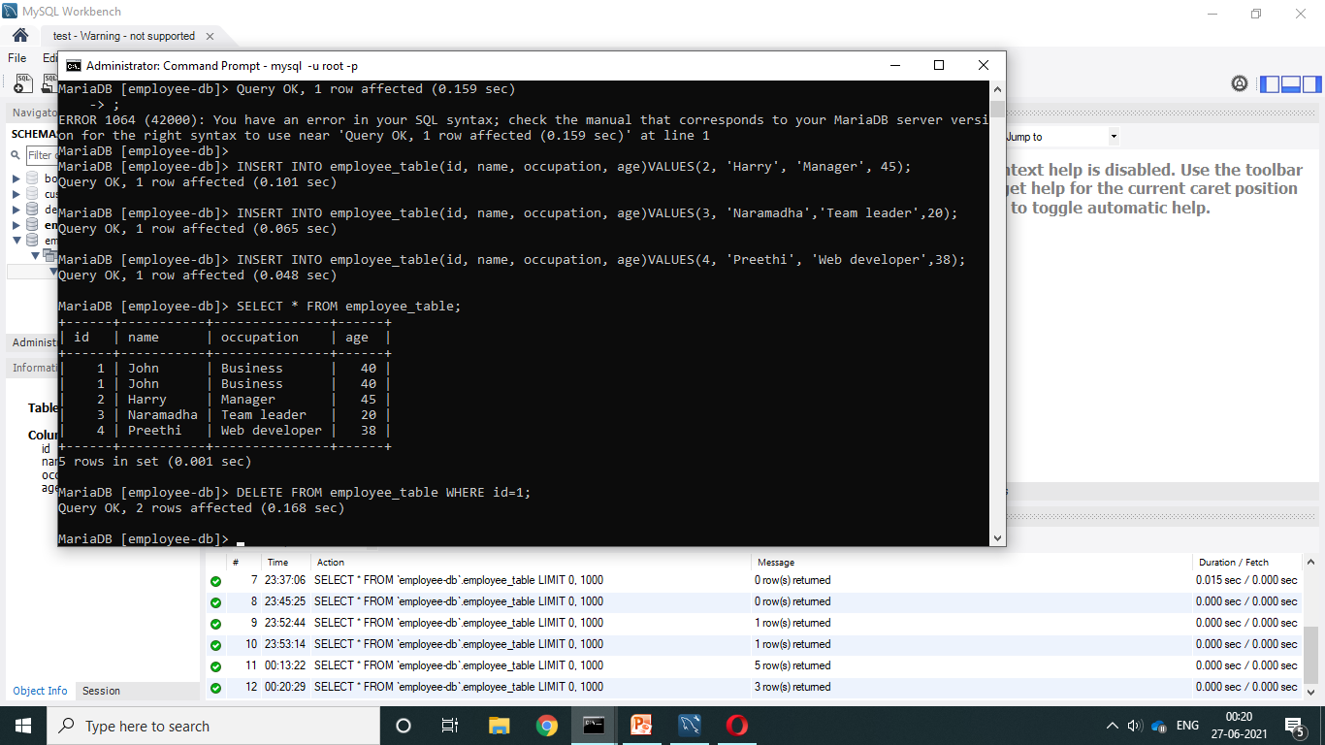
DELETE /REMOVE DATA

Slide 22
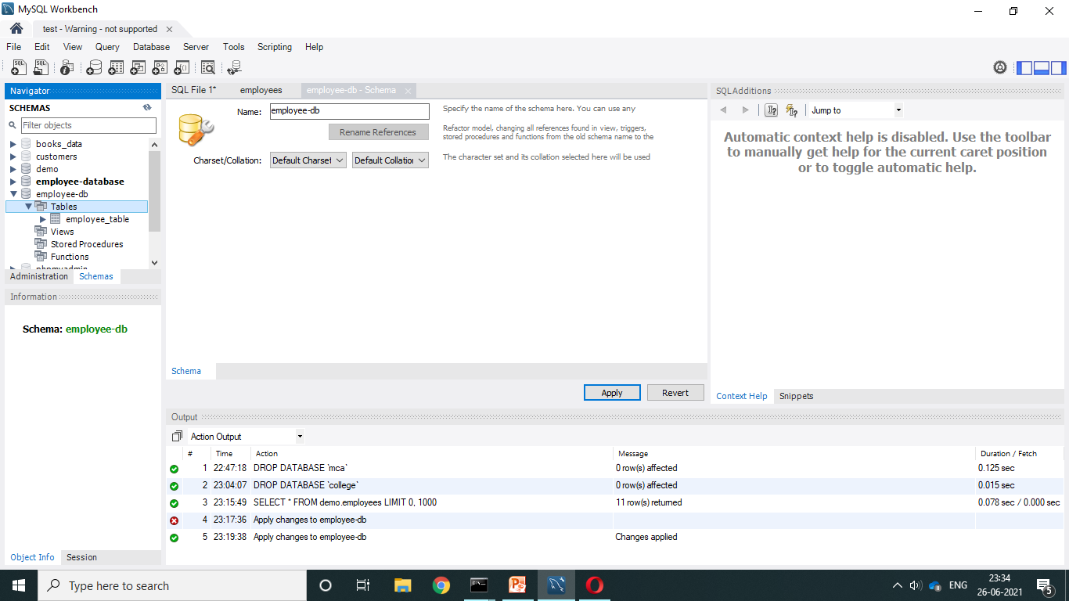
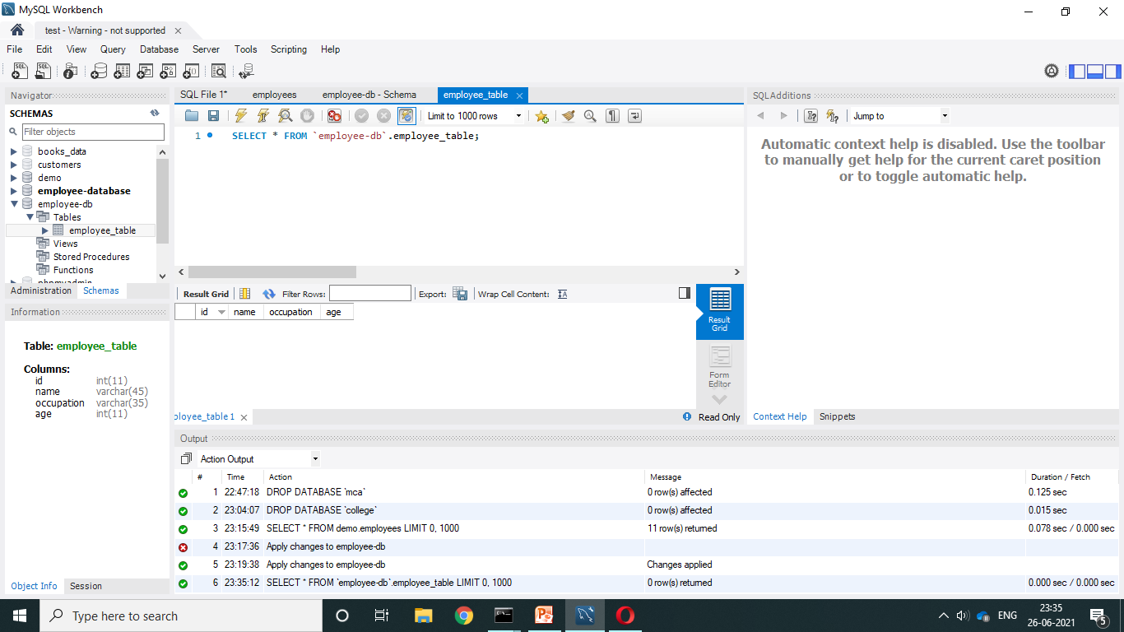

Slide 23
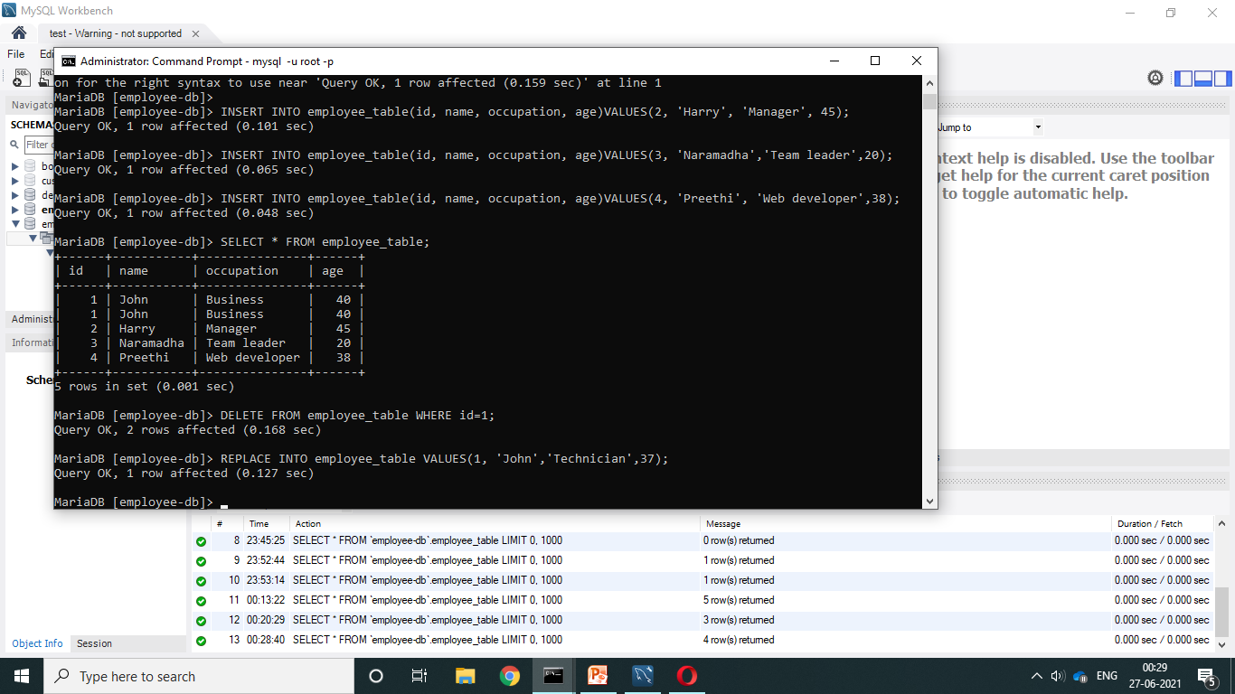
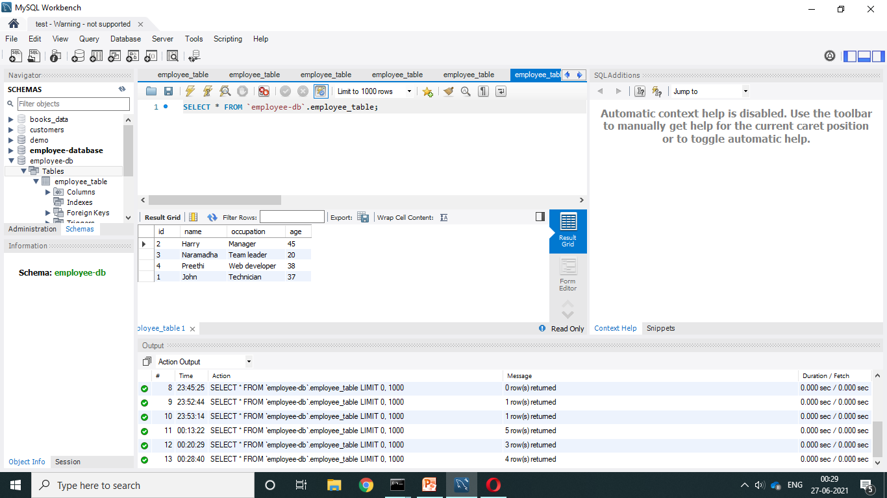
REPLACE INTO

Slide 24
QUERIES
Create Database:
CREATE DATABASE employee_db;
Display Database:
SHOW databases;
Select one database:
USE employee_db;
Create Table:
CREATE TABLE employee_table (
ID INT NOT NULL AUTO_INCREMENT,
NAME VARCHAR(50) NOT NULL,
DESIGNATION VARCHAR(50) NOT NULL.
AGE INT NOT NULL,
PRIMARY KEY(ID)
);

Slide 25
Display Tables :
SHOW TABLES;
Show Table Structure:
DESC employee_db;
Add New Column in table:(Single column)
ALTER TABLE employee_table ADD CONTACT VARCHAR(50) NOT NULL AFTER AGE;
Multiple Columns:
ALTER TABLE employee_table
ADD CITY VARCHAR(10) NOT NULL,
ADD GENDER VARCHAR(10) NOT NULL;
Modify Particular Column :
ALTER TABLE employee_table MODIFY CONTACT VARCHAR(30) NOT NULL;
Table Rename:
ALTER TABLE employee_table RENAME TO EMP-LIST;
INSERT Records:
INSERT INTO EMP-LIST VALUES (NULL, ‘RAM’, ‘UI DESIGNER’, 35, ‘9876543017’, ‘ CHENNAI’, ‘MALE’);
INSERT INTO EMP-LIST (ID,NAME,DESIGNATION,AGE,CONTACT,CITY,GENDER) VALUES (NULL, ‘John’, ‘Team leader’, 38, ‘9943256091’, ‘KARUR’, ‘MALE’),(NULL, ‘Sanjay’, ‘Manager’, 40, ‘9994693261’, ‘SALEM’, ‘MALE’);

Slide 26
DELETE Row:
DELETE FROM EMP-LIST WHERE ID=2;
View Records:
SELECT * FROM EMP-LIST;
UPDATE Rows:
UPDATE EMP-LIST SET CONTACT=‘9876543210’, CITY=‘HOSUR’ WHERE ID=3;
Clear entire Records:
TRUNCATE TABLE EMP-LIST;
Retrieve Particular Data :
SELECT NAME,AGE FROM EMP-LIST;
Retrieve particular city:
SELECT NAME,AGE ,CITY FROM EMP-LIST WHERE CITY=‘HOSUR’ ;
Condition based data:
SELECT NAME,AGE ,CITY FROM EMP-LIST WHERE CITY=‘HOSUR’ AND AGE>=35;
SELECT NAME,AGE ,CITY FROM EMP-LIST WHERE CITY=‘HOSUR’ OR CITY=‘SALEM’;

Slide 27
Both AND /OR:
SELECT NAME,AGE ,CITY FROM EMP-LIST WHERE (CITY=‘HOSUR’ OR CITY=‘SALEM’) AND AGE>=45 ORDER BY CITY;
Unique values:
SELECT DISTINCT CITY FROM EMP-LIST;
COUNT:
SELECT COUNT CITY FROM EMP-LIST;
SELECT COUNT (DISTINCT CITY) FROM EMP-LIST;
Pagination:
SELECT * FROM EMP-LIST LIMT 0,10;
SELECT * FROM EMP-LIST ORDER BY ID DESC LIMT 0,1;
MAXIMUM Values:
SELECT MAX(AGE) FROM EMP-LIST;
MINIMUM Values:
SELECT MIN (AGE) FROM EMP-LIST;
AVERAGE;(AGREGATTION FUNCTIONS)
SELECT AVG(AGE) FROM EMP-LIST;
Round value:
SELECT ROUND(AVG),0)FROM EMP-LIST;
SUM:
SELECT SUM(AVG),0)FROM EMP-LIST;

Slide 28
Count Report Group wise:
SELECT GENDER, COUNT(ID) FROM EMP-LIST GROUP BY GENDER;
SELECT GENDER, COUNT(ID) AS TOTAL FROM EMP-LIST GROUP BY GENDER;
Retrieve starting two letter (name) LIKE ‘ %’;
SELECT NAME FROM EMP-LIST WHERE NAME LIKE ‘RA%’;
Retrieve last two letters LIKE ‘% ’;
SELECT NAME FROM EMP-LIST WHERE NAME LIKE ‘%AM’;
Retrieve centre letter LIKE ‘%A%’;
SELECT NAME FROM EMP-LIST WHERE NAME LIKE ‘%A%’;
Instead of starting letter from RA it display all other Name: NOT LIKE
SELECT NAME FROM EMP-LIST WHERE NAME NOT LIKE ‘RA%’;
Retrieve only particular city employee details alone:
SELECT * FROM EMP-LIST WHERE CITY IN (‘SALEM’,’CHENNAI’);
Instead of Salem and Chennai it display all other city :
SELECT * FROM EMP-LIST WHERE CITY NOT IN (‘SALEM’,’CHENNAI’);

Slide 29
Between :
SELECT NAME,AGE FROM EMP-LIST WHERE AGE BETWEEN 24 AND 30;
ATTENDANCE TABLE:
CREATE TABLE ATTENDANCE (
AID INT NOT NULL AUTO_INCREMENT,
ID INT NOT NULL,
ADATE DATE NOT NULL,
ASTATUS VARCHAR(10) NOT NULL,
PRIMARY KEY(AID)
);
Retrieve data from other table:
SELECT * FROM ATTENDANCE WHERE ID=1;
SELECT ID,COUNT(ADATE) AS WORKING FROM ATTENDANCE GROUP BY ID;
SELECT ID,COUNT(ADATE) AS WORKING , COUNT (IF (ASTATUS=‘P’,1, NULL)) AS PRESENT FROM ATTENDANCE GROUP BY ID;

Slide 30

JOIN QUERY’S Refer: https://www.javatpoint.com/mysql-join

Slide 31
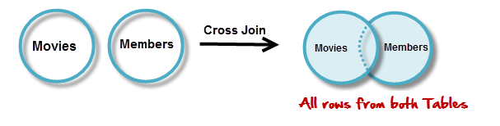
What are JOINS?
Joins help retrieving data from two or more database tables.
The tables are mutually related using primary and foreign keys.
Cross JOIN:
Cross JOIN is a simplest form of JOINs which matches each row from one database table to all rows of another.
In other words it gives us combinations of each row of first table with all records in second table.
Suppose we want to get all member records against all the movie records, we can use the script shown below to get our desired results.
SELECT * FROM `movies` CROSS JOIN `members`

Slide 32
INNER Join
The INNER JOIN is used to return all rows from multiple tables where the join condition is satisfied. It is the most common type of join.
Syntax:
SELECT columns FROM table1 INNER JOIN table2 ON table1.column = table2.column;
LEFT Outer Join
The LEFT OUTER JOIN returns all rows from the left hand table specified in the ON condition and only those rows from the other table where the join condition is fulfilled.
Syntax:
SELECT columns FROM table1 LEFT [OUTER] JOIN table2 ON table1.column = table2.column;
Right Outer Join
The MySQL Right Outer Join returns all rows from the Right-hand table specified in the ON condition and only those rows from the other table where he join condition is fulfilled.
Syntax:
SELECT columns FROM table1 RIGHT [OUTER] JOIN table2 ON table1.column = table2.column;

Slide 33



Slide 34

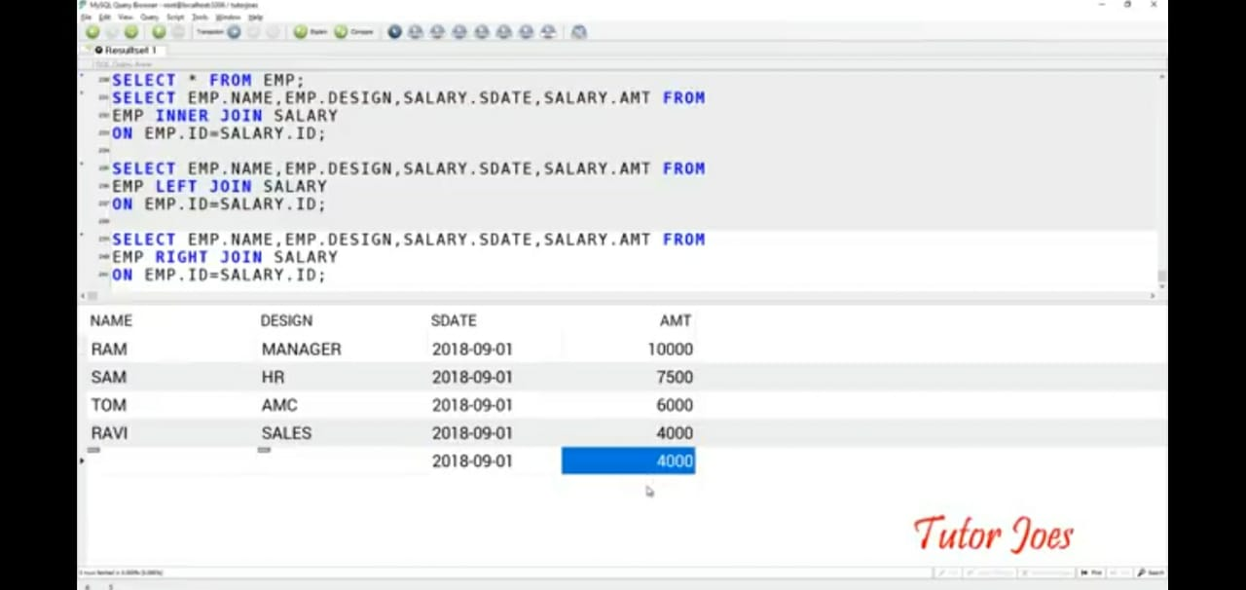
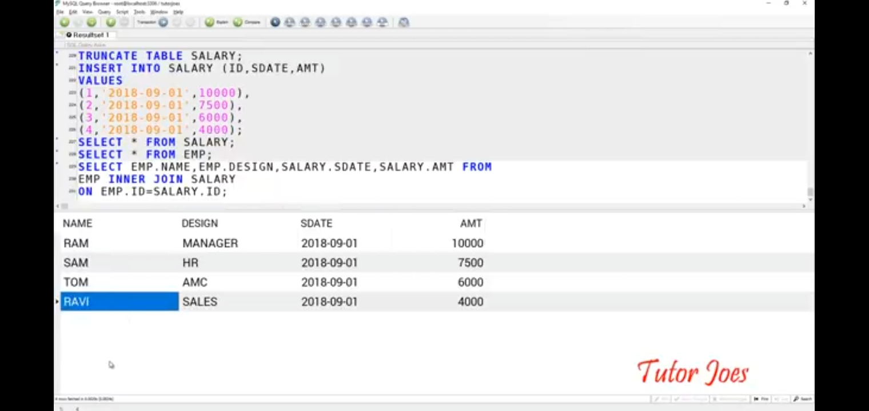

Slide 35
REFERENCE:
MySQL Join – javatpoint
SQL Joins - W3Schools
https://youtu.be/cpbd7CLAqtw (MySQL)
https://youtu.be/HXV3zeQKqGY (SQL)
https://www.javatpoint.com/mysql-workbench
https://www.javatpoint.com/how-to-install-mysql

Slide 36


